Slide 1
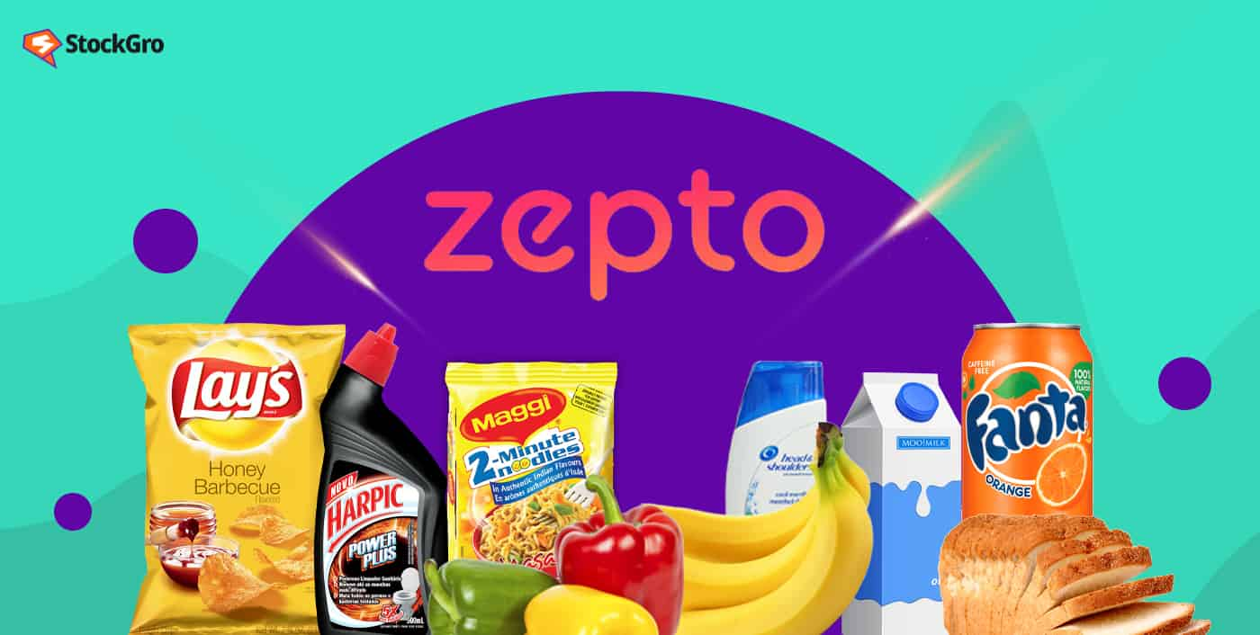
CASE STUDY 1
“ Groceries delivered in 10 minutes”

Slide 2
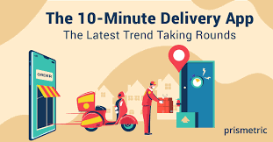





INCREASED A NOTABLE HIKE IN STARTING OF 2022
OVERVIEW :
Established in 2021 by Aadit palicha and kaivalya
Vohra .
Main mission to provide ultra fast delivery and
unparalleled convenience.
high quality groceries & essentials to customer
within minutes. Uses a advanced technology
to maintain the regulatory of the orders
EXPANDED RAPIDLY THROUGHOUT 2022 AND 2023

Slide 3
Business model of Zepto
Operates on hyperlocal quick e-commerce model , priority for it is speed and convenience which has delivery time less than 10mins
Dark stores : uses the strategically located Dark stores (warehouse ) where all the required items that to be delivered in 10 mins are stored here . It is not open for public
Delivery fleet : they depend on network of delivery personnel who takes care of door delivery services
Revenue : generates more through the deliveries and also includes the partners, promotions and special services also .

Slide 4

FAST DELIVERY: (10MINS)
It would be greater task and a competitive advantage in the quick commerce space
URBAN FOCUS :
It targets mostly the highly populated cities it allows a better utilization of resources and maximizes the efficiency of deliveries
Strengths
(S)
TECHNOLOGY INTEGRATION:
Advanced technology to handle the inventory management , order processing and also for rapid service
DARK STORE MODEL:
It enables to streamlined operations and faster fulfilment and to high demand urban areas effectively

Slide 5
HIGH OPERATIONAL COSTS :
Maintenance of DARK STORES require a very huge amount of investments and also operational costs
WEAKNESSES
SCALABILTY CHALLENGES :
Rapid expansion in a very short time can strain the resources makes it challenging to maintain service quality and efficiency
LIMITED PRODUCT RANGE :
A curated may not be able to cater all customer needs, potentially limits the market compared to larger grocery chains

Slide 6



OPPORTUNITIES
MARKET EXPANSION :
There is a potential for growth into new cities and regions which would in turn increase the market growth and the base
PARTNERSHIPSANDCOLLABORATIONS:
The way to partnerships with the brands , retailers, or even tech firms which enhances the service and also helps to expand the product range
TECHNOLOGYADVANCEMENTS:
Continuous investment in technology helps to lead further ways which helps to increase delivery speed, the efficiency and regulates the customer experiences

Slide 7



THREATS
Economic downturns or shifts in the consumer spending could affect demand for rapid or premium delivery services
Changes in the regulation related to logistics ,labour or food safety coulde be impactable in certain cases
Competition in this sector is highly competitive with huge amount of players buying for market share

Slide 8
What makes ZEPTO unique ?
It differentiates itself with others through a variety of key factors
Speed of delivery
Dark store model
Urban focus
Curated inventory
Customer experience
Technology
Investment & growth strategy: has significant capitalfunding which helped in rapid scaling , expanded to new markets and continuous enhancements in the teahnology

Slide 9

ZEPTOS COMPETITORS
Swiggy insta mart (hike in 2023 by 150%)
Big basket (owned by tata)(hike in 2022 by 35%)
Grofers (now blin kit)(hike in 2022 by 75%)
Amazon pantry
Jio mart (hike in 2022 by 80%)
Dunzo (hike in 2022 by 96%)
Nature’s basket (hike in 2022 by 46%)
ZEPTO :
Hiked in 2023 with approx. of 300% from 80cr to 320cr (in rupees)

Slide 10
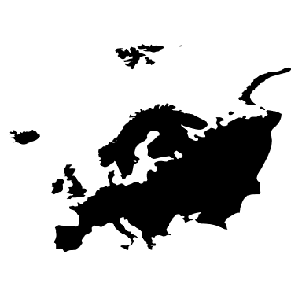
THANK YOU

